Slide 1
Azure Data Lake & Factory Technical Deep Dive –Day 3
Sashank Pappu
Azure Data & AI Specialist

Slide 2


Sashank Pappu
Azure Data & AI Specialist.
Certified from MIT on ‘Advanced Analytics and Big Data Challenges’. Technology Enthusiast and Data Specialist. Certified Designer in Computer Vision
• Microsoft Certified Power BI Developer. • Microsoft Certified Azure Machine Learning Developer from Microsoft Virtual Academy • Certified on Practical Data Analytics with Microsoft Cortana Intelligence Suite.
9+ years of total experience as Data Specialist and Data Engineer.
Certifications
Experience
Currently working as Independent Consultant on Azure Data & AI and Enterprise Trainer on Azure Data Analytics , Cortana Intelligence Suite and Cognitive Sciences
Expert facilitator and corporate behavioral trainer with 5 years of experience in designing programs, content development , Data Analytics and Machine Learning.
Role
Training
Sri Nag Sashank
You can see me on – Sashankpappu.com

Slide 3




The session will span for 5 days & it is mandatory to attend all the days.
Self-Paced labs have been developed & access will be shared during the session.
The “Azure Subscriptions” are limited & pre-sent via email to only a registered audience.
The remaining audience can participate in the leaning. However, it DOES NOT come with “Azure Subscriptions” & request users to arrange on their own.
A proctor will be available to take your queries via “Chat” window. Kindly “MUTE” and do not disturb the presenter.
The sessions are recorded. Will be made available through LMS at the end of series.
Note: More trainings on the same & similar topics would be delivered in near future. Keep your options open.
Guidelines for the event

Slide 4
What we can learn together ??
Azure Data Ecosystem
SQL DW
Storage (Blob Vs Data Lake)
Data Lake Storage
Data Lake Analytics
URL : https://github.com/jumpstartninjatech/HeroSolutionsVLIT-Data

Slide 5
Next 5 Days
Azure SQL DB & DW
Azure Data Lake & Analytics
Azure Data Factory
Azure Databricks
Azure Databricks with ADF
Azure Data Bricks with Delta
Streaming with Databricks
Cosmos DB

Slide 6
To Be More Precise
11:00-11:30 : Overview Data Ecosystem & SQL DW
11:30-12:15 : Data Lake StorageGen2 Creation & Security
12:15-12:20 : BREAK !!!
12:20-1:30 : Data Lake Analytics Tables and Schemas

Slide 7
Questionnaire
To be taken after each section .
Request you to ask the questions in Chat window .
Will respond to them after a logical break point in each topic.
This would make the workshop interesting and approachable .
Request not to use Phones or get distracted for next 3 hours .

Slide 8
Expected Outcome!
Azure Data Ecosystem – When to use what !
Architectural Standards & Best Practices in Azure .
Hands on Project ready confidence.
Tackling Real world challenges in Azure Data Platform
Real world use cases and architectures for huge clients.

Slide 9
Time to adapt is shrinking
A hundred years ago, the average lifespan of a company listed on the S&P 500 index was 67 years
In the 2020s…
75% of the S&P 500 will be new (not on the index today)
25% of the S&P 500 will
be ones on the index today
Source: BBC
Notes:
Compared to the past, what’s unique about the disruption happening today is its pace. During past revolutions, firms had many years, even decades, to adapt. Today, that is no longer the case. One indicator of just how fast the landscape is changing is the longevity of companies on the S&P 500, an index of leading US companies.
A hundred years ago, the average lifespan of a company listed on the S&P 500 was 67 years. Today, that average lifespan has decreased to just 15 years.
Experts predict that in the next decade, only 25% of the companies currently listed on the S&P 500 will remain there, and the other 75% will be replaced by new companies.
The bottom line is, today’s organizations must adapt quickly to change, using new technologies that fuel competitive advantage, or risk getting left behind.
-------------------------------------------
Statistics source:
BBC, 2012, quoting Richard Foster - http://www.bbc.com/news/business-16611040
"The average lifespan of a company listed in the S&P 500 index of leading US companies has decreased by more than 50 years in the last century, from 67 years in the 1920s to just 15 years today, according to Professor Richard Foster from Yale University. Professor Foster estimates that by 2020, more than three-quarters of the S&P 500 will be companies that we have not heard of yet."

Slide 10
Convergence accelerates digital transformation
Cloud
Data
Intelligence
Notes:
Three key trends are converging to accelerate digital transformation:
First, the cloud provides new and powerful ways to economically and reliably capture and persist the vast new data resources.
Second, thanks to the exponential proliferation of small, inexpensive chips and processors, computers are as ubiquitous as the people who use them. This is increasing the availability of vast and detailed data about products, businesses, market conditions, devices, and consumers and is creating new opportunities for businesses to tailor their strategy to market demand.
Finally, machines are everywhere, constantly creating, collecting and making sense of the data in our midst. With the magic of machine learning, along with the limitless computing power of the cloud, this data is giving rise to intelligence that is augmenting human capabilities in exciting new ways. This marks a unique point in history…an opportunity for organizations to automate and innovate quickly to increase their speed of business.

Slide 11
Time to adapt is shrinking
A hundred years ago, the average lifespan of a company listed on the S&P 500 index was 67 years
In the 2020s…
75% of the S&P 500 will be new (not on the index today)
25% of the S&P 500 will
be ones on the index today
Source: BBC
Notes:
Compared to the past, what’s unique about the disruption happening today is its pace. During past revolutions, firms had many years, even decades, to adapt. Today, that is no longer the case. One indicator of just how fast the landscape is changing is the longevity of companies on the S&P 500, an index of leading US companies.
A hundred years ago, the average lifespan of a company listed on the S&P 500 was 67 years. Today, that average lifespan has decreased to just 15 years.
Experts predict that in the next decade, only 25% of the companies currently listed on the S&P 500 will remain there, and the other 75% will be replaced by new companies.
The bottom line is, today’s organizations must adapt quickly to change, using new technologies that fuel competitive advantage, or risk getting left behind.
-------------------------------------------
Statistics source:
BBC, 2012, quoting Richard Foster - http://www.bbc.com/news/business-16611040
"The average lifespan of a company listed in the S&P 500 index of leading US companies has decreased by more than 50 years in the last century, from 67 years in the 1920s to just 15 years today, according to Professor Richard Foster from Yale University. Professor Foster estimates that by 2020, more than three-quarters of the S&P 500 will be companies that we have not heard of yet."

Slide 12
Data Ecosystem

Slide 13



Information Management
Information Management
Data Sources
Data Factory
Apps
Data Catalog
Event/IoT Hubs
Sensors and devices
Data
Notes:
T: Information Management includes Data Factory, Data Catalog, and Event Hubs.

Slide 14
Big Data Stores
Information Management
Big Data Stores
Data Sources
Data Factory
Data Lake Store
Data Catalog
SQL Data
Warehouse
Apps
Event Hubs
{ }
Cosmos DB
Sensors and devices
Data
Notes:
T: Azure provides a variety of storage options, including Blobs. Here we’ll dive into the two main storage options with Cortana Intelligence, starting with Data Lake Store.

Slide 15

Machine Learning and Analytics
Information Management
Big Data Stores
Machine Learning and Analytics
Data Sources
Data Factory
Data Lake Store
Machine Learning
Data Catalog
SQL Data
Warehouse
Data Lake Analytics
Apps
HDInsight
(Hadoop and Spark)
Event Hubs
{ }
Cosmos DB
Stream Analytics
Sensors and devices
Azure Analysis Services
Azure Time Series Insight
Data
Intelligence
Notes:
T: Advanced analytics services are where data starts turning into insight that drives intelligent action.

Slide 16
Intelligence
Information Management
Big Data Stores
Machine Learning and Analytics
Intelligence
Data Sources
Data Factory
Data Lake Store
Machine Learning
Cognitive Services
Data Catalog
SQL Data
Warehouse
Data Lake Analytics
Bot Service
Apps
HDInsight
(Hadoop and Spark)
Event Hubs
{ }
Cosmos DB
Cortana
Stream Analytics
Sensors and devices
Azure Analysis Services
Azure Time Series Insight
Data
Intelligence
Notes:
T: Our intelligence capabilities fall into three areas – Cognitive Services, Bot Framework and Cortana.

Slide 17

Transform data into intelligent action
Information Management
Big Data Stores
Machine Learning and Analytics
Intelligence
Data Sources
People
Data Factory
Data Lake Store
Machine Learning
Cognitive Services
Data Catalog
SQL Data
Warehouse
Data Lake Analytics
Bot Service
Apps
Web
Event Hubs
HDInsight
(Hadoop and Spark)
{ }
Cosmos DB
Cortana
Mobile
Apps
IoT Hubs
Stream Analytics
Dashboards & Visualizations
Bots
Sensors and devices
Azure Analysis Services
Azure Time Series Insight
Power BI
Automated Systems
Data
Intelligence
Action
Notes:
T: Cortana Intelligence provides everything you need to transform your organization’s data into intelligent action. Next, let’s take a look at another demo.

Slide 18


Build applications that understand people
Intelligence
Vision
Speech
Language
Knowledge
Search
Cognitive Services
Computer Vision
Speaker Recognition
Text Analytics
Academic
Bing Web Search API
Content Moderator
Bing Speech
Bing Spell Check
Entity Linking
Bing Image Search API
Bot Service
Face
Custom Speech Service
Web Language Model
Knowledge Exploration
Bing Video Search API
Cortana
Emotion
Linguistic Analysis
Recommendations
Bing News Search API
Video
Language Understanding
QnA Maker
Bing Auto Suggest API
Translator
Faces, images, emotion recognition and video intelligence
Spoken language processing, speaker recognition, custom speech recognition
Natural language processing, sentiment and topics analysis, spelling errors
Complex tasks processing, knowledge exploration, intelligent recommendations
Bing engine capabilities for Web, Autosuggest, Image, Video and News
Notes:
What’s incredibly unique is the intelligence capabilities Cortana Intelligence offers, building on years of Microsoft research and innovation. These capabilities enable our customers to build intelligent systems and agents that can augment their organizational capabilities. For example, organizations can interact with customers and stakeholders in new ways and infer intent with vision, face, speech, text and sentiment analysis to customize responses and drive appropriate actions.
Microsoft Cognitive Services, a set of cloud services, APIs and SDKs that enable organizations to build intelligent systems that can see, hear, interpret and understand the world around you and makes all applications more intelligent, engaging and discoverable. Cognitive Services expands the existing perceptual intelligence capabilities like Vision, Speech, Text and Face detection to include new cognitive capabilities such as Emotion and customized Language Understanding. What we showcased with www.how-old.net is one example of what is possible.
T: Next, Bot Service.

Slide 19











Your bots – wherever your users converse
Intelligence
Accelerate development cycles
Enrich your bots
Boost operational efficiencies
</>
Cognitive Services
Bot Service
Develop your way
Built in code editor
Channel support
Cognitive Services
Powered by Azure Functions
Continuous deployment
Cortana
Quick start templates
Integrated chat window
Direct Line support
Embedded web chat
Scale on demand
Reduced dev ops
Start quickly with built-in templates
Reach your customers on multiple channels
Boost the power of bots with Azure services
No server management or patching needed
Scale out automatically
Pay only for what you use
Notes:
Azure Bot Service enables rapid intelligent bot development, bringing together the power of the Microsoft Bot Framework and Azure Functions. Build, connect, deploy and manage intelligent bots that interact naturally wherever your users are talking – from your app or website to text/sms to Skype, Slack, Facebook Messenger, Kik, Office 365 mail, Teams and other popular services. Allow your bots to scale based on-demand and you pay only for the resources you consume.
T: Next, Cortana.

Slide 20
Microsoft SQL Platform Continuum
Hybrid Cloud
Shared Lower Cost
On Premises
Platform as a Service
SQL
SQL
SQL
Azure SQL Database Virtualized Databases
Infrastructure as a Service
SQL
SQL
SQL
SQL Server in Azure VM Virtualized Machines
Virtual
SQL
SQL
SQL
SQL Server Private Cloud Virtualized Machines + Appliances
Physical
SQL
SQL Server Physical Machines (raw iron)
Dedicated Higher Cost
Off Premises
Higher Administration
Lower Administration

Slide 21
Azure SQL Database
Relational database-as-a-service, fully managed by Microsoft
For cloud-designed apps when enterprise-grade features and near-zero administration are key
Elastic Scale and Performance
Business Continuity and Data Protection
Self-managed and Familiar
Predictable performance levels
Scale up/down & out/in
Dashboard views of DB metrics
Self-service restore
Disaster recovery
Compliance-enabled
Self-managed
Programmatic APIs
Familiar tools and language
Enterprise-grade database platform with cloud economics

Slide 22
Azure SQL Database Service Tiers
Basic
Standard
Premium
Intended Use
Light transactional loads
Go-to option for most business applications
High throughput and business-critical databases
Availability
99.99%*
Size
2 GB
250 GB
500 GB
Performance
•
••
•••
Business Continuity
•
••
•••
Incremental performance and features with easy upgrade and downgrade
*The 99.99% availability SLA does not apply to Web and Business editions, which continue to be supported at 99.9% availability.

Slide 23
Azure SQL Database
Elastic Scale and Performance
Business Continuity and Data Protection
Self-managed and Familiar
Predictable performance levels
Scale up/down & out/in
Dashboard views of DB metrics
Self-service restore
Disaster recovery
Compliance-enabled
Self-managed
Programmatic APIs
Familiar tools and language

Slide 24
Scalable Performance
Basic, Standard, and Premium provide increasing performance levels
Relative performance is expressed in database throughput units (DTUs)
DTU is a blended measure of CPU, read IO, write IO, and memory
Scale performance up/down via portal, APIs, PS, or T-SQL to reflect actual or anticipated demand
Database remains online while scaling
Hourly billing improves cost efficiency
P3
P2
P1
S2
S0
S1
B
DTUs
5
10
20
50
100
200
800
Performance is easily scaled up or down to meet changing workload and business needs

Slide 25
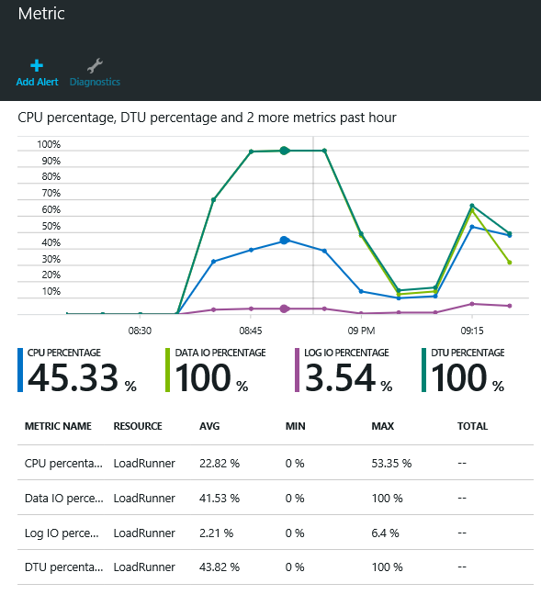
Rich Near-real-time Monitoring
Monitor resource consumption over time and set user-configurable alerts and notifications to guide scaling decisions
Rich metrics include % DTU usage, resource usage, database size, connection health
Dashboard views in the portal, or via APIs and DMVs
In-depth DMVs aid troubleshooting (e.g. at the query level)
Use monitoring and alerts to understand and manage resource utilization

Slide 26
Azure Database Migration Journey
Assess
Migrate
Optimize
https://datamigration.microsoft.com/

Slide 27
Azure Database Migration

Slide 28
Azure SQL DW

Slide 29
INTRODUCTION
The Case for Cloud Date Warehousing
Exploring Azure SQL Data Warehouse
MPP Concepts
Exploring SQL DW Components

Slide 30
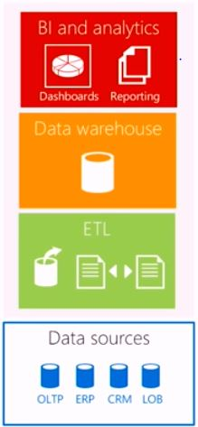
THE TRADITIONAL DATA WAREHOUSE
The single source of truth or the central repository for all the data in the company

Slide 31
What would it take to build my own DB?
HARDWARE
5 Enterprise class servers or VM’s
Sufficient RAID enabled disk or SSD
Hardware load balancing
Power/Cooling/Rackspace
Network capable of geo-replication
Secure Facility
SOFTWARE
Server software License
DB software license
Maintenance costs
Systems management software
Configuration management tools
Billing software
Backup tools
PERSONNEL
DBA
System Admin OS expert
Networking specialist
Storage manager
Operation staff
Technical management

Slide 32

Data warehouse fairytale
Once upon a time, data warehouse was an appliance who required fixed combinations of storage and compute, often underutilizing expensive resources. Meaning monstrous hardware was lying unused.

Slide 33
What is Azure SQL Data warehouse
Cloud– Azure PaaS
Distributed Database– an MPP
Processing Massive Volumes– up to PBs
SQL Capabilities– a relational DB that can
Grow ,Shrink & Pause - use what you need, when you need it..

Slide 34
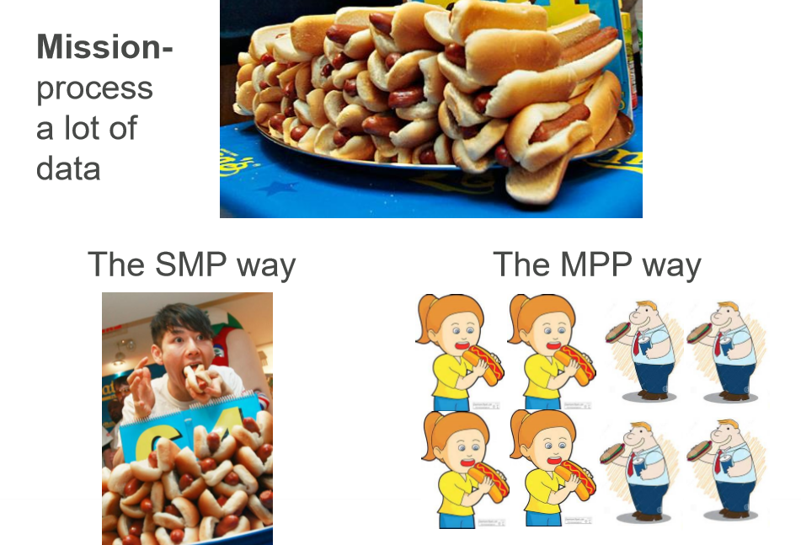

Slide 35
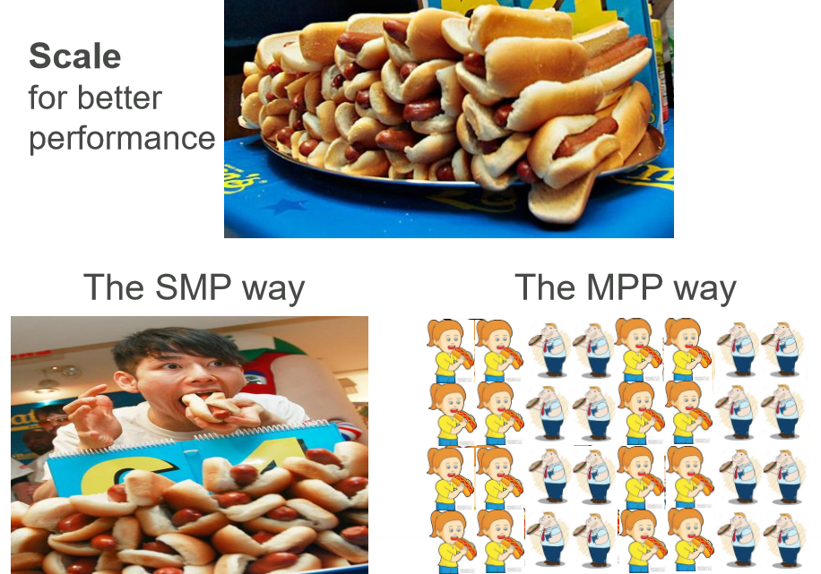

Slide 36
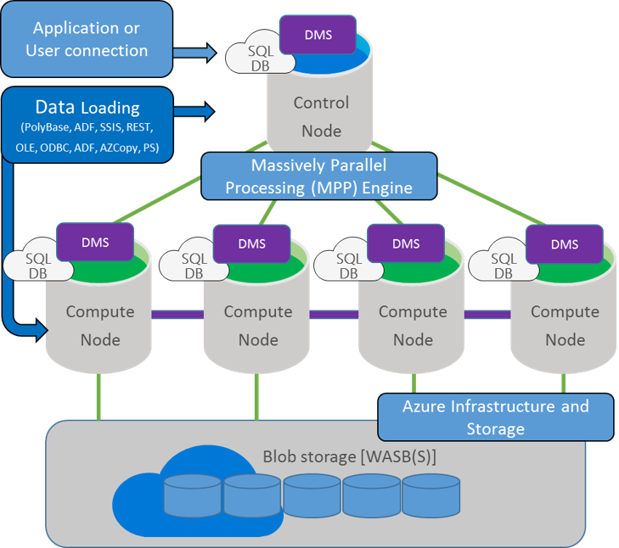

Slide 37
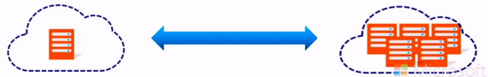
Rapidly deploy and gain insights
Spin up for heavy workloads, cycle down for daily activity .
Buy time to insight based on what you need, when you need
Choose the combo of compute and storage that meets your
needs.
Resize in
< 1 Minute
From Any Size to
Any Size
On-Demand
Compute

Slide 38

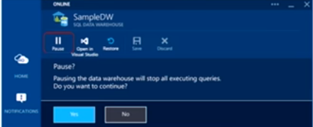
When Paused, Pay only for Storage
Use it only when you need it — no reloading / restoring
Save Costs with Dynamic Pause and Resume
When paused, cloud-scale storage is min cost.
Policy-based (i.e. Nights/weekends)
Automate via PowerShell/REST API
Data remains in place

Slide 39
Data Warehouse Units
Introducing DWUs
Data Warehouse Units
Abstraction of underlying resources
-CPU
- Memory
- IOPS
• A measure of metrics
- Scan/Aggregation, Load, CT AS
• Scale your SQL DW by changing DWI-Js
- On-the-fly

Slide 40
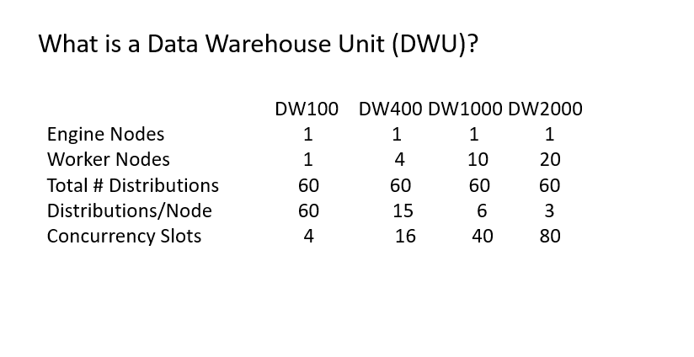
What is a Data Warehouse Unit (DWU)?

Slide 41
Architecture for DW100
Azure Storage Blob(s)
Azure SQL Data Warehouse
D1
D2
D3
D4
D5
D6
D7
D1
D9
D10
D8
D11
D12
D13
D14
D15
D16
D17
D18
D19
D20
D21
D22
D23
D24
D25
D26
D27
D28
D29
D30
Engine
Worker 1
D31
D32
D33
D34
D35
D36
D37
D38
D39
D40
D41
D42
D43
D44
D45
D46
D47
D48
D49
D50
D51
D52
D53
D54
D55
D56
D57
D58
D59
D60

Slide 42
Architecture for DW600
Azure Storage Blob(s)
Azure SQL Data Warehouse
Worker 1
D1
D2
D3
D4
D5
D6
D7
D1
D9
D10
D8
Worker 2
D11
D12
D13
D14
D15
D16
D17
D18
D19
D20
Engine
Worker 3
D21
D22
D23
D24
D25
D26
D27
D28
D29
D30
Worker 4
D31
D32
D33
D34
D35
D36
D37
D38
D39
D40
Worker 5
D41
D42
D43
D44
D45
D46
D47
D48
D49
D50
Worker 6
D51
D52
D53
D54
D55
D56
D57
D58
D59
D60

Slide 43
PROVISIONING A SQL DATA WAREHOUSE

Slide 44
Preparing to Deploy SQL DW
Provisioning SQL DW from Portal.
Querying SQL DW
Provisioning SQL DW with Power Shell
Provisioning SQL DW with T-SQL
INTRODUCTION

Slide 45
PREPARING TO DEPLOY SQL DW
Deployment considerations
Azure subscription : Where will the deployment be billed? Account access
Resource group : New or existing?
Logical server : New or existing?
Database name : Must be unique to its server
Performance settings : Start with 400 DWU, adjust later
Security Authentication : server administrator, firewall rules

Slide 46
Deployment methods
Azure Portal (server & database)
Browser
PowerSheII (server & database)
Needs Azure PowerShell module
T-SQL (database only)
Visual Studio 2013(or later) with SSDT
SQL Server Management Studio, sqlcmd

Slide 47
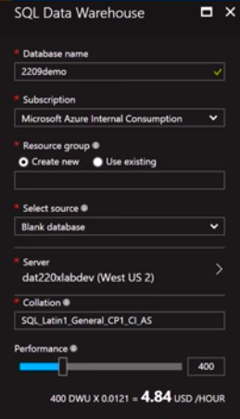
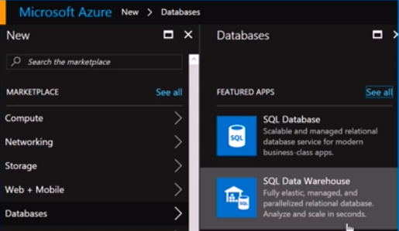
Provisioning : Azure Portal

Slide 48
Provisioning : PowerShell
Login- AzureRmAccount …
Get- AzureRmSubscription …
New-AzureRmSqlDatabase
-RequestedServiceObjectiveName “DW400”
-DatabaseName "DAT200Demo "
-ServerName "DAT200Svr"
-ResourceGroupName " DAT200RG"
-Edition "DataWarehouse"

Slide 49
Provisioning : T-SQL
CREATE DATABASE DAT200Demo
COLLATE SQL_Latin1_General_CP1_AS
(EDITION=‘datawarehouse‘,SERVICE_OBJECTIVE = ‘DW400’
MAXSIZE= 10240 GB) ;
Create logical server in Portal or with PowerShell

Slide 50
DESIGNING TABLES AND
LOADING DATA

Slide 51
INTRODUCTION
Distributing Data
Designing Tables
Loading Data
Indexes and Statistics
Lab: Designing Tables and Loading Data

Slide 52
Partitioning tables in SQL Data Warehouse
Benefits of partitioning : Works upon the ADW Distribution .
Benefits to loads
Benefits to queries : Applied to Filtered Partitions.
WITH (
CLUSTERED COLUMNSTORE INDEX , DISTRIBUTION = HASH([ProductKey]) ,
PARTITION ( [OrderDateKey] RANGE RIGHT FOR VALUES
(20000101,20010101,20020101 ,20030101,20040101,20050101 ) )
)

Slide 53
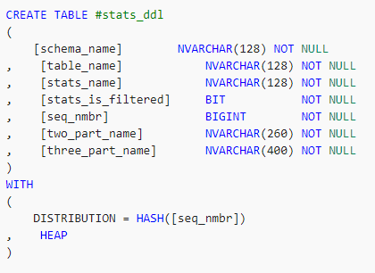
Temporary tables in SQL Data Warehouse
Best for transformation where the intermediate results are transient
Temporary tables offer a performance benefit because their results are written to local rather than remote storage . But global tables are not available yet.
Temporary tables are slightly different in Azure SQL Data Warehouse than Azure SQL Database as they can be accessed from anywhere inside the session, including both inside and outside of a stored procedure.
Create a temporary table

Slide 54
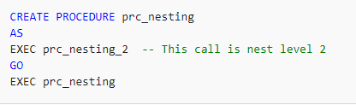
Stored procedures in SQL Data Warehouse
Limitations and Usage :
SQL Data Warehouse support a maximum of 8 nesting levels.
Temporary stored procedure
Encryption option

Slide 55
DESIGNING TABLES
Data Distribution Concepts
Defined:
"The process of distributing or spreading out ... "

Slide 56
Why Distribute Data
Divide & conquer: lots of small queries to solve
Evenly spreading the data can lead to balanced
use of the appliance resources

Slide 57


Distributed Data = 60 Buckets of Water

Slide 58
MPP SQL Table Geometries
Distributed:
A table structure that is distributed across all MPP nodes of the Data Warehouse Database
HASH : where the value of a single column gets hashed to define the distribution
number where the records will get inserted
ROUND_ROBIN: where the records are distributed in a "round robin" manner
across all distributions

Slide 59
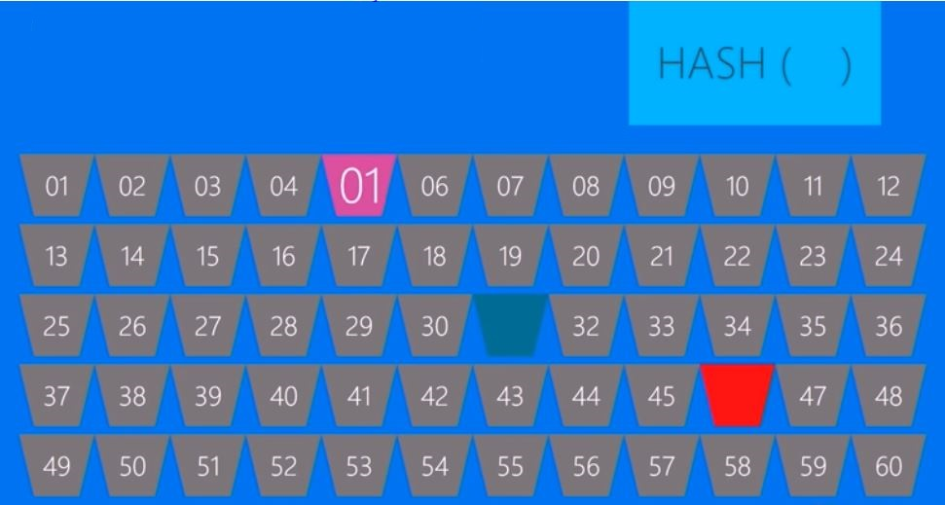
HASH DISTRIBUTION

Slide 60
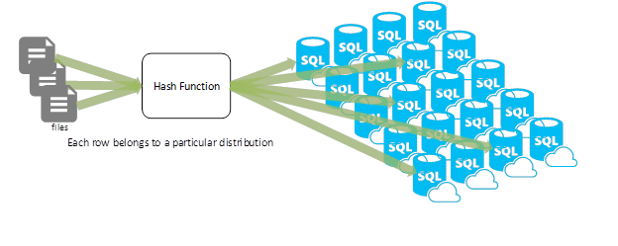
Hash Distribution

Slide 61
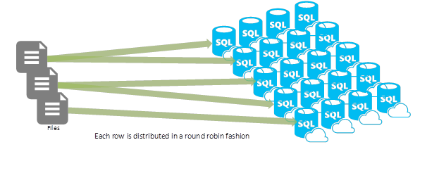
Round Robin

Slide 62
To HASH or ROUND ROBIN?
Use HASH distributed tables when:
• For fact/detail tables if you DO have a common distribution key which is used in multi-distributed table joins
• If Full Table Scans do not provide acceptable performance
Use ROUND ROBIN distributed tables when:
• Multiple "primary/foreign key"-like joins are common
• When the data is an initial loading table

Slide 63
BIG DATA INTEGRATION
AND
SQL DW MANAGEMENT

Slide 64
INTRODUCTION
Integrating SQL DW in a Big Data Solution
Importing and Querying with PolyBase
Managing and Securing SQL DW
Protecting and Recovering Data
Demo: Integrating SQL DW in a Big Data Solution

Slide 65
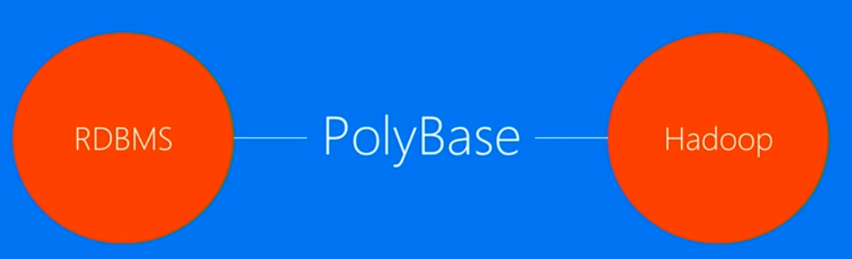
POLYBASE
Big Picture
Provides a scalable, T-SQL compatible query processing
framework for combining data from both universes

Slide 66
Why use PolyBase?
Query data stored in Hadoop from SQL Server or ADW.
Query data stored in Azure Blob Storage
Import data from Hadoop, Azure Blob Storage, or Azure Data Lake Store
Export data to Hadoop, Azure Blob Storage, or Azure Data Lake Store.
Push computation to Hadoop

Slide 67
Poly Base Use Cases
Load Data
Use Hadoop as an
ETL tool to cleanse
data before loading
to data warehouse
with PolyBase
Interactively Query
Analyse relational
data with semi-
structured data using
split-based query
processing
Age-out Data
Age-out data to
HDFS and use it as
'cold' but query-able
storage

Slide 68

Query
Results
SELECT TOP 10 *
FROM SQL SERVER S
JOIN Hadoop H
S.Key = H.Key
JOIN Blob B
and S.Key = B.Key
SQL DW
W/ PolyBase
Hadoop
Azure Blob
Storage

Slide 69
SECURING AND PROTECTING DATA

Slide 70
Who manages what?
ON PREMISES INFRASTRUCTURE PLATFORM SOFTWARE
Physical/Virtual as a Service as a Service as a Service
Applications
Applications
Applications
Applications
Data
Data
You manage
Data
Data
You scale, make
resilient and manage
Runtime
Runtime
Runtime
Runtime
Middleware
Middleware
Middleware
Middleware
You scale, make resilient and manage
Scale,Resilience and Management by Microsoft
O/S
O/S
O/S
O/S
Virtualization
Virtualization
Virtualization
Virtualization
Scale, Resilience and Management by Microsoft
Servers
Servers
Servers
Servers
Managed by Microsoft
Storage
Storage
Storage
Storage
Networking
Networking
Networking
Networking
Windows Azure Virtual Machines
Windows Azure Virtual Machines

Slide 71
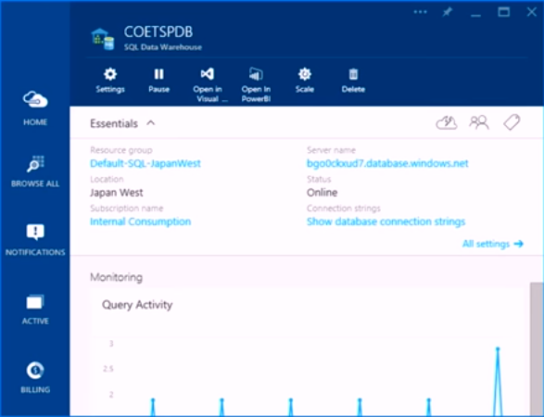
Managing a Azure SQL DW database
Monitor
Pause/Resume
Scale
Delete
Open with Visual
studio/PowerBI

Slide 72
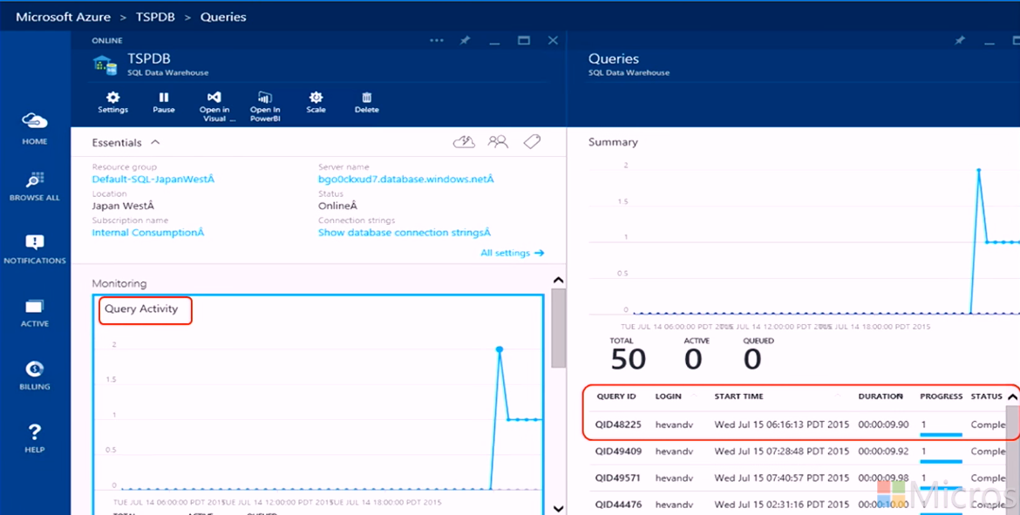
Monitoring – Query Activity

Slide 73
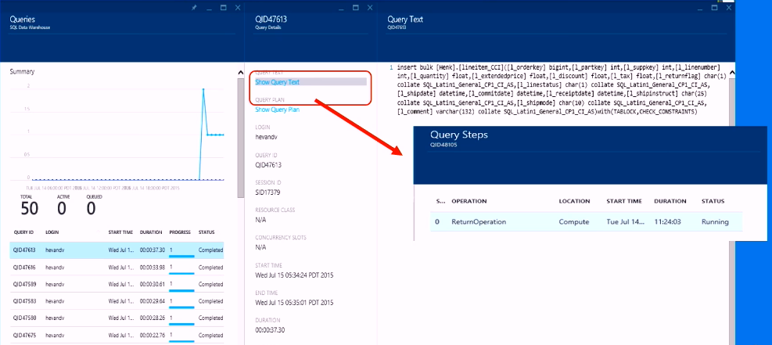
Monitoring – Query Activity

Slide 74
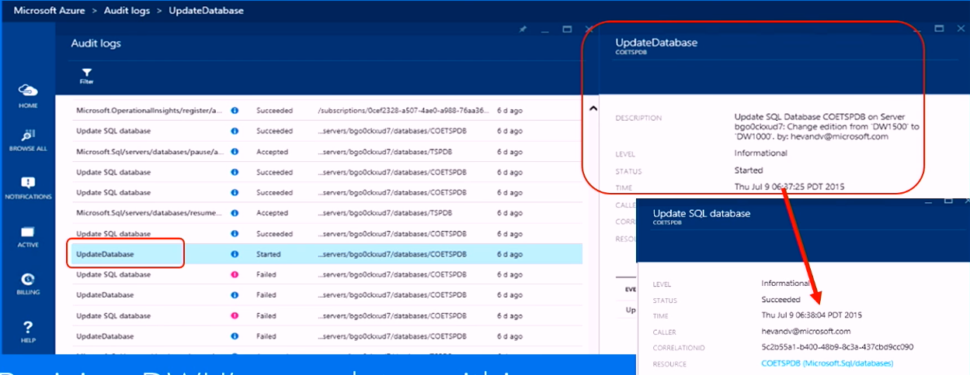
Notification log
Resizing DWU’s completes within seconds

Slide 76
Azure Storage Accounts

Slide 77
Azure Storage Components:
Blobs – Highly scalable, REST based cloud object store
Tables – Massive auto-scaling, NoSQL store
Queues – Reliable messaging at scale for cloud services
Disks – Persistent Premium & Standard disks for Azure IaaS VMs
Files – SMB 3.0 access to Azure Storage
Azure Import/Export – Ship data in HDD
AZCopy – High-performance data upload , download, & copy

Slide 78
Durability Options
Locally Redundant Storage (LRS)
Stores 3 replicas of the data within a single zone (facility) in a single region
Provides data durability for disk, node and rack failures
Geo Redundant Storage (GRS)
Stores 6 replicas of the data across two regions (3 in each region)
Provides additional durability to protect data against major regional natural disasters (e.g., tornado, hurricane, fire, etc, destroying a whole region)
Updates across regions are performed asynchronously
Zone Redundant Storage (ZRS)
Stores 3 replicas of the data across multiple zones (facilities) within a single region or across regions
Provides additional durability to protect data against zone failures (e.g., fire burning down a facility)

Slide 79
Access Control
Symmetric Shared Key AuthN
Trusted service that owns the storage accounts
Shared Access Signature (SAS) Delegated AuthZ
3rd party services
Mobile device applications
Restricted access for services
Allow client applications to directly communicate with Storage rather than scaling a proxy web service
Public (Blob service only)
CDN access
Browser based access

Slide 80
Approach of Data is Changing !!!
Data Lake

Slide 81
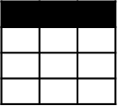
Evolving Approaches to Analytics EDWs to Data Lakes
Extract
Transform
Load
OLTP
…
EDW
(SQL Svr, Teradata, etc)
Original Data
ETL Tool
(SSIS, etc)
Transformed Data
BI Tools
ERP
LOB
Data Marts
Data Lake(s)
Dashboards
Apps

Slide 82
Evolving Approaches to Analytics EDWs to Data Lakes
Extract
Transform
Load
OLTP
…
EDW
(SQL Svr, Teradata, etc)
Original Data
ETL Tool
(SSIS, etc)
Transformed Data
BI Tools
ERP
LOB
Data Marts
Data Lake(s)
Dashboards
Devices
Social
Ingest (EL)
Apps
Sensors
Original Data
Web

Slide 83
Evolving Approaches to Analytics EDWs to Data Lakes
Extract
Transform
Load
OLTP
…
EDW
(SQL Svr, Teradata, etc)
Original Data
ETL Tool
(SSIS, etc)
Transformed Data
BI Tools
ERP
LOB
Data Marts
Data Lake(s)
Dashboards
Devices
Social
Ingest (EL)
Scale-out Storage & Compute
(HDFS, Blob Storage, etc)
Apps
Sensors
Original Data
Web
Streaming data
Transform & Load

Slide 84
Evolving Approaches to Analytics EDWs to Data Lakes
Extract
Transform
Load
OLTP
…
EDW
(SQL Svr, Teradata, etc)
Original Data
ETL Tool
(SSIS, etc)
Transformed Data
BI Tools
ERP
LOB
Data Marts
Data Lake(s)
Dashboards
Devices
Social
Ingest (EL)
Scale-out Storage & Compute
(HDFS, Blob Storage, etc)
Apps
Sensors
Original Data
Web
Streaming data
Transform & Load

Slide 85
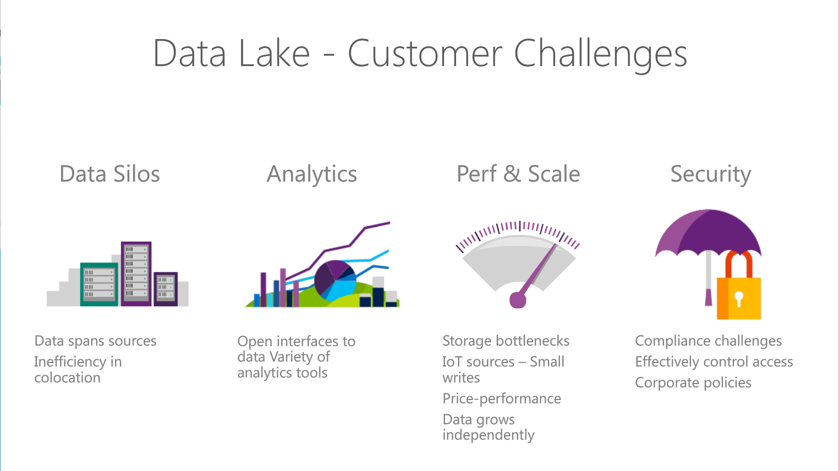
Notes:
Objetive – explain what are the Customer challeges that Azure Data Lake solution addresses
Read through the points.

Slide 86
The Intelligent Lake
Petabytes of Data + Intelligence
Data Lake Store
No-limits data Lake
Petabyte-sized files
Trillions of objects
Scalable I/O for parallel analytics
Enterprise-grade Security
Data Lake Analytics
Analytics job service
Scale instantly
Scale per job
Infused with Artificial Intelligence

Slide 87
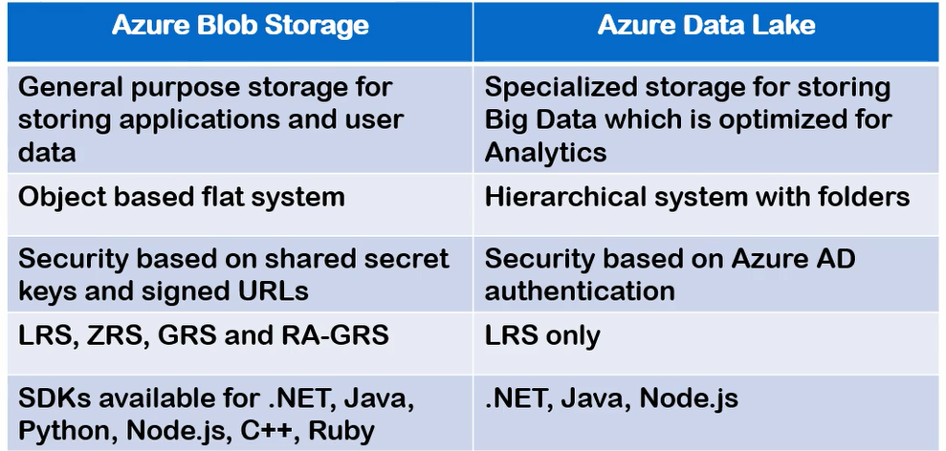
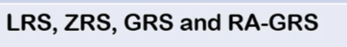
Azure Data Lake Storage Gen 1 Vs BLOB

Slide 88
ADLS Gen1 + BLOB = ADLS Gen 2
Use | Data Lake Store | Blob Storage | Data Lake Gen 2
Hot/Cold Storage Tiers | No | Yes | Yes
Redundant Storage | No | Yes | Yes
AD Security | Yes | No | Yes
HDFS Compatible | Yes | No | Yes

Slide 89
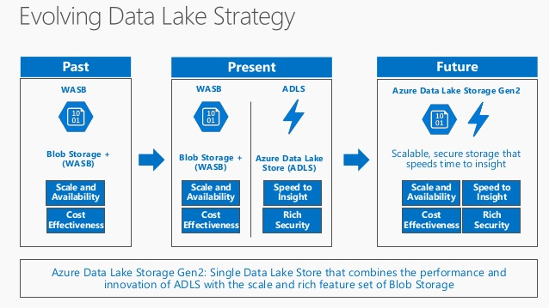
ADLS Gen1 + BLOB = ADLS Gen2

Slide 90
Azure Data Lake Use Cases

Slide 91
Retail Scenario Implementation
ON-PREMISES
CLOUD
CONSUMPTION
Massive Archive
Web Portals
Initial one time import
“Landing Zone”
Data Lake Store
DW (many instances)
On-Prem HDFS
Mobile Apps
via AzCopy
Curated Data
Data is portioned into multiple SQL DWs (one per data consumer. Several hundred consumers)
Power BI
Incremental
updates
Experimentation
Machine Learning
A/B testing at scale. Drive changes based on actual
Customer behavior
Do ML at Scale (Customer Segmentation & Fraud Detection)
Active Incoming Data
Jupyter
Notebooks
Notes:
Discuss how the previous scenario can fir into a concrete scenario for retail sector .
Here we use ADLS as store to where dat is uploaded from on-premise HDFS cluster and it analysed to extract additional insight using machine learning techniques
To do fraud prediction or customer segmentation. The data can then be suploaded to SQL data warehose to which various clients connect to conume data.

Slide 92
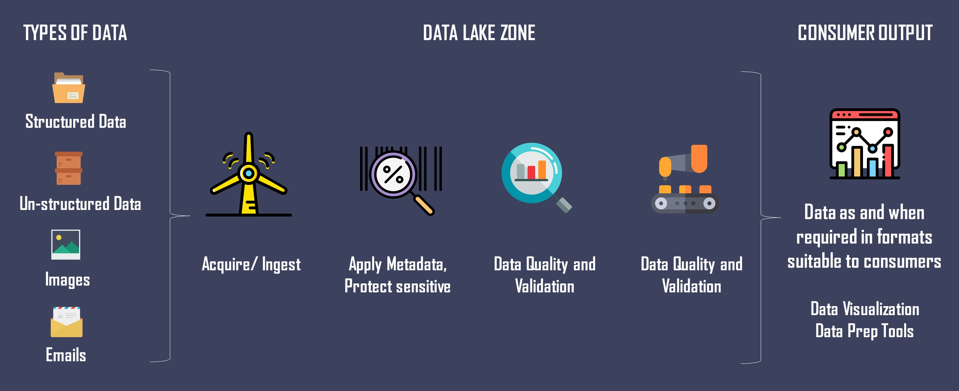
Zones in

Slide 93
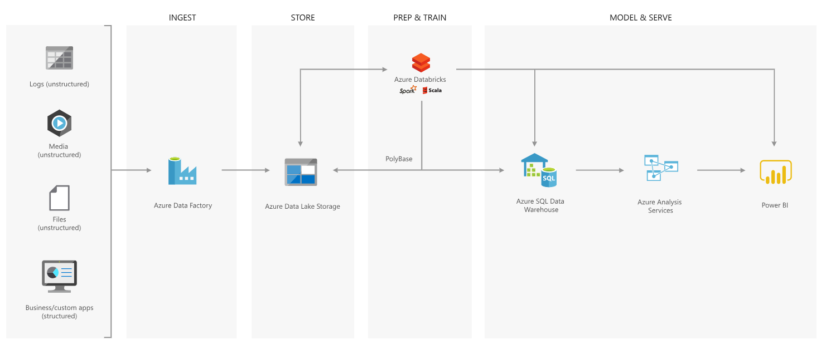
Best Practices – Modern Data Warehouse

Slide 94
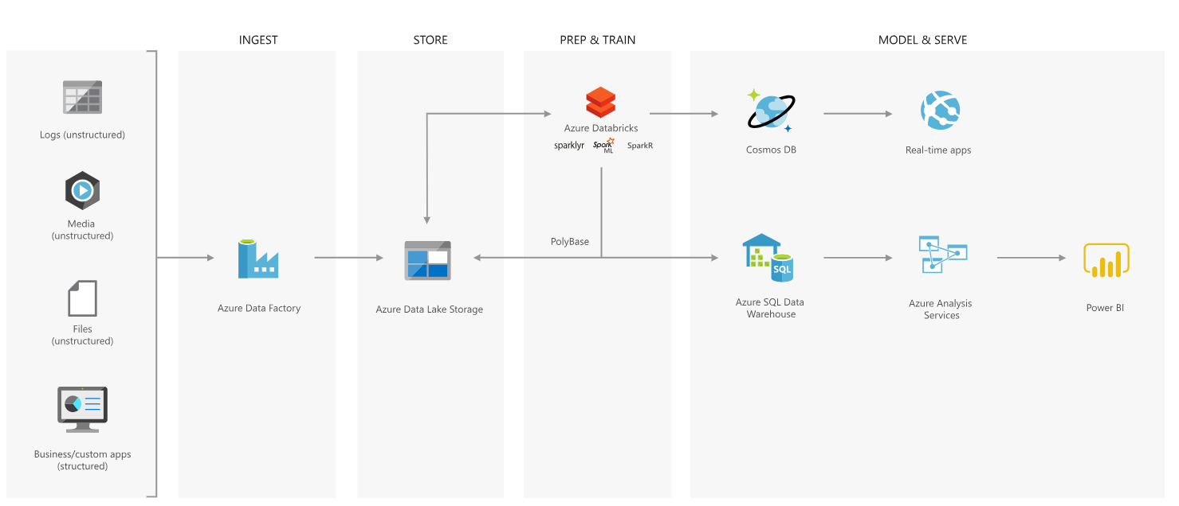
Advanced Analytics Approach

Slide 95

Azure Data Lake Store
Notes:
Lets have a look at the Data Lake Store service in more detail

Slide 96
Introducing Azure Data Lake Store
A hyper-scale repository for big data analytics workloads
Store ANY DATA in its native format
HADOOP FILE SYSTEM (HDFS) for the cloud
ENTERPRISE GRADE
No limits to SCALE
Optimized for analytic workload PERFORMANCE
Notes:
Objective: This is the introductory slide for Azure Data Lake Store.
Talking Points:
Microsoft describes Data Lake Store as a “hyper-scale repository for big data analytic workloads.” Azure Data Lake Store is an enterprise wide hyper-scale repository for big data analytic workloads.
Any Data - This lets you store all of your data and analyze them in their native format.
Hadoop File System - Azure Data Lake Store is a Hadoop file system which is compatible with HDFS and works with the Hadoop ecosystem.
Enterprise Grade - Azure Data Lake Store provides industry standard availability and reliability and also provides enterprise grade security for all data.
Scale - Azure Data Lake Store provides unlimited storage and is suitable for storing a variety of data.
Performance - Azure Data Lake Store is built for running large scale analytic systems that require massive throughput to query and analyze large amounts of data.

Slide 97

The Data Lake Approach
Ingest all data regardless of requirements
Store all data
in native format without schema definition
Do analysis
Using analytic engines like Hadoop and ADLA
Devices
Social
Batch queries
LOB applications
Video
Devices
Interactive queries
LOB applications
Social
Sensors
Real-time analytics
Web
Sensors
Video
Machine Learning
Relational
Web
Clickstream
Data warehouse
Relational
Clickstream
Notes:
Motivation – explain that ALS Store is Load Transform and Extract rather than ETL. You essentially postpone the schema definition until the extraction time.
A data lake is an enterprise wide repository of every type of data collected in a single place. Data of all types can be arbitrarily stored in the data lake prior to any formal definition of requirements or schema for the purposes of operational and exploratory analytics. Advanced analytics can be done using Hadoop, Machine Learning tools, or act as a lower cost data preparation location prior to moving curated data into a data warehouse. In these cases, customers would load data into the data lake prior to defining any transformation logic.
This is bottom up because data is collected first and the data itself gives you the insight and helps derive conclusions or predictive models.

Slide 98


Any data
Devices
Video
Unstructured
Semi-structured
Structured
Clickstream
Web
Social
Sensors
Relational
LOB applications
Notes:
Objective: This slide is about how Azure Data Lake Store can store any type of data.
Talking Points:
Data Lake Store allows you to store relational and non-relational data. It also does not require a schema to be defined before the data is loaded. This data can be from devices, videos, and web applications. Here data can be further classified into:
Unstructured Data - This data either does not have predefined data model or is not organized. It is typically text-heavy and may contain data like dates, numbers, and facts.
Semi-Structured Data - These are self-describing structures that do not conform with the formal structure of data models associated with the relational database or other forms of data tables.
Structured Data - This data resides in a fixed field within a record file. It includes data contained in relational databases and spreadsheets.

Slide 99



Durable and highly available
Automatically replicates your data
Three copies within a single region
Highly available
Notes:
Objective: This slide shows how data is durable and highly available with Azure Data Lake Store.
Talking Points:
One of the prior requirements is the availability of data at any place and any time. ADL Store provides industry standard availability and reliability in the following ways:
The ADL Store Automatically replicates the data to help against unexpected hardware failures and make sure it is available when you need it.
Azure Data Lake automatically replicates your data to help guard against unexpected hardware failures and make sure it's available when you need it. We keep three copies within a single region.

Slide 100
Unlimited storage
PB
TB
GB
Unlimited account sizes
Individual file sizes from gigabytes to petabytes
No limits to scale
TB
PB
Notes:
Objective: This slide shows how Azure Data Lake supports unlimited storage.
Talking Points:
Azure Data Lake Store provides unlimited storage and is suitable for storing a variety of data for analytics.
Azure Data Lake has unbounded scale with no limits to how much data can be stored in a single account.
While other cloud storage offerings might restrict individual file sizes to 5 terabytes, Azure Data Lake can store very large files in the petabytes (200x larger) with immediate read/write access and high throughput useful for scenarios like high resolution videos, scientific, medical, large backup data, event streams, web logs, IoT scenarios, and more.
Everything can be collected and stored in Azure Data Lake without restriction or prior understanding of business requirements.

Slide 101
Hands on – Data Lake Gen2
Creation of Data Lake Gen2 Account

Slide 102
Security Considerations

Slide 103
Data Protection
Protect the data at rest
Protect the data in transit
Support browser cross-domain access
Control who can access data
Audit storage access

Slide 104
Understand storage account keys
Data is generated or consumed by custom applications
The applications are written in various languages.
Create authorized apps in Active Directory to control access to the data in blobs

Slide 105
Understand shared access signatures
You shouldn't share storage account keys with external third-party applications
For untrusted clients, use a shared access signature (SAS)
Types of shared access signatures
service-level shared access signature
account-level shared access signature

Slide 106
Control network access to your storage account
Storage accounts accept connections from clients on any network
To limit access to selected networks, you must first change the default action.
You can restrict access to specific IP addresses, ranges, or virtual networks

Slide 107
Understand Advanced Threat Protection for Azure Storage
Often any protection only shows you that an intrusion has already occurred.
What you really want is a way to be notified when suspicious activity is happening
Advanced Threat Protection, detects anomalies in account activity
It then notifies you of potentially harmful attempts to access your account.

Slide 108
Break for 5 mins !!!

Slide 109
Azure Data Lake Analytics
2016/05/17

Slide 110
Quick Recap

Slide 111
ADL VS SQL DB
Azure Data Lake
ADL Analytics + ADL Store
SQL DB
SQL Query + DB Storage

Slide 112
Familiar syntax to millions of SQL & .NET developers
Unifies declarative nature of SQL with the imperative power of C#
Unifies structured, semi-structured and unstructured data
Distributed query support over all data
U-SQL
A new language for Big Data

Slide 113
History

Slide 114
History
Bing needed to…
Understand user behavior
And do it…
At massive scale
With agility and speed
At low cost
So they built …
Cosmos
Cosmos
Batch Jobs
Interactive
Machine Learning
Streaming
Thousands of Developers

Slide 115
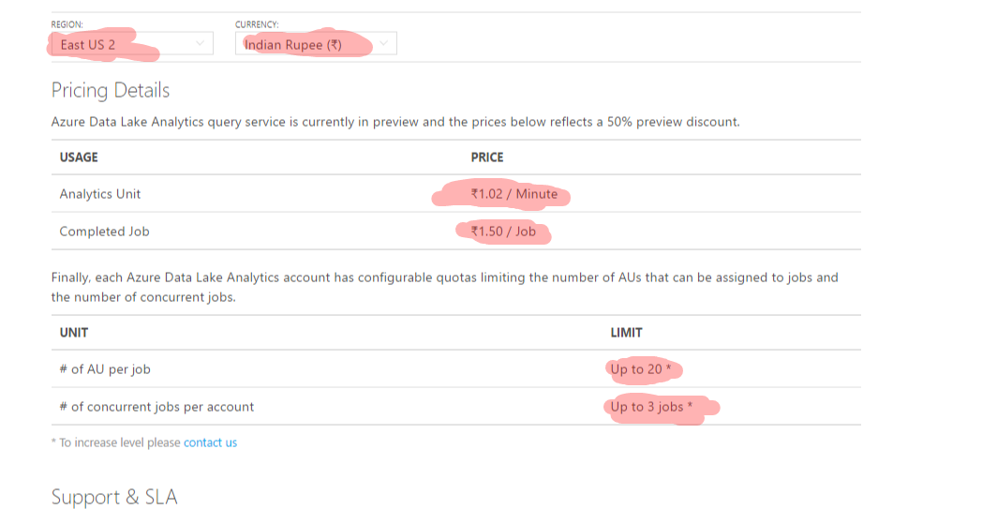
Pricing

Slide 116
Azure Data Lake Analytics (ADLA) Demo

Slide 117
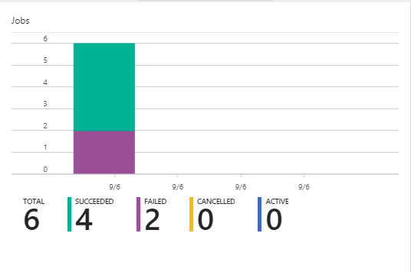

Slide 118
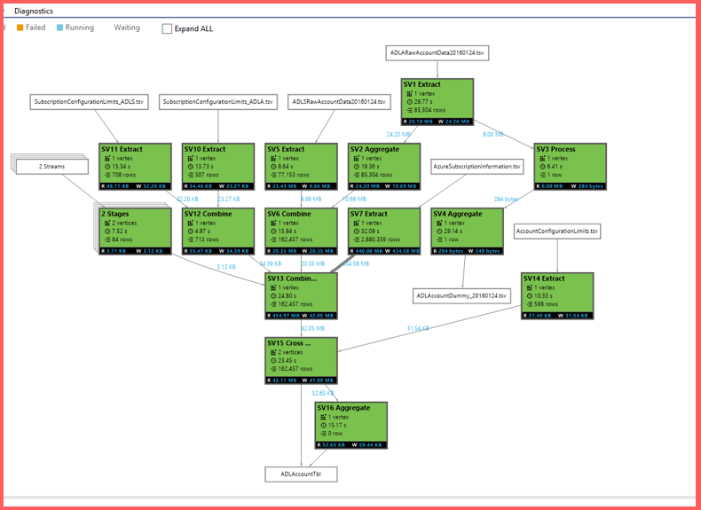

Slide 119
Job Scheduling States, Queue, Priority

Slide 120
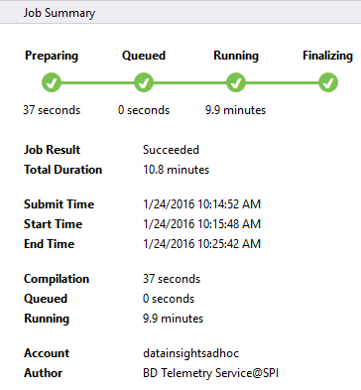
Job Status

Slide 121
UX
Job State
Preparing
New
The script is being compiled by the Compiler Service
Compiling
All jobs enter the queue.
Queued
Queued
Are there enough ADLAUs to start the job?
Scheduling
Starting
If yes, then allocate those ADLAUs for the job
Running
Running
The U-SQL runtime is now executing the code on 1 or more ADLAUs or finalizing the outputs
Finalizing
Ended
(Succeeded, Failed, Cancelled)
Ended
The job has concluded.

Slide 122
U-SQL Job Compilation

Slide 123
U-SQL Compilation Process
U-SQL Metadata Service
Compilation output (in job folder)
C#
managed dll
C++
Unmanaged dll
Compiler & Optimizer
Algebra
Other files
(system files, deployed resources)
Deployed to Vertices

Slide 124

The Job Folder
Inside the Default ADL Store:
/system/jobservice/jobs/Usql/YYYY/MM/DD/hh/mm/JOBID
/system/jobservice/jobs/Usql/2016/01/20/00/00/17972fc2-4737-48f7-81fb-49af9a784f64

Slide 125
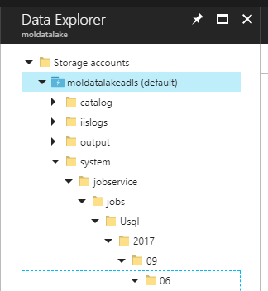
Job folder Structure
/system/jobservice/jobs/Usql/YYYY/MM/DD/hh/mm/JOBID

Slide 126
ADLAUs
Azure
Data
Lake
Analytics
Unit
Parallelism N = N ADLAUs
1 ADLAU ~=
A VM with 2 cores and 6 GB of memory

Slide 127
Vertex Execution

Slide 128
Store Basics
A VERY BIG FILE
Files are split apart into Extents.
Extents can be up to 250MB in size.
For availability and reliability, extents are replicated (3 copies).
Enables parallelized read
1
2
3
4
5
1
2
3
4
5
1
2
3
4
5
1
2
3
4
5

Slide 129
Parallel writing
Front-end machines for a web service
Log files
Simultaneous
uploads
Azure Data lake

Slide 130
As file size increases, more opportunities for parallelism
Extent
Vertex
Extent
Vertex
Extent
Vertex
Extent
Vertex

Slide 131
ADLA File Management
Hands on

Slide 132
The importance of partitioning input data

Slide 133
Search engine clicks data set
A log of how many clicks a certain domain got within a session
SessionID Domain Clicks
3 cnn.com 9
1 whitehouse.gov 14
2 facebook.com 8
3 reddit.com 78
2 microsoft.com 1
1 facebook.com 5
3 microsoft.com 11

Slide 134
Data Partitioning Compared
Extent 1
Extent 2
Extent 3
Extent 1
Extent 2
Extent 3
FB
FB
FB
FB
WH
CNN
WH
CNN
WH
CNN
WH
FB
WH
WH
CNN
FB
CNN
CNN
File:
Keys (Domain) are scattered across the extents
U-SQL Table partitioned on Domain
The keys are now “close together” also the index tells U-SQL exactly which extents contain the key

Slide 135
Click Data :
CREATE TABLE SampleDBTutorials.dbo.ClickData ( SessionId int, Domain string, Clinks int, INDEX idx1 //Name of index CLUSTERED (Domain ASC) //Column to cluster by ); INSERT INTO SampleDBTutorials.dbo.ClickData SELECT * FROM @clickdata;

Slide 136
Find all the rows for cnn.com
// Using a File
@ClickData =
SELECT
Session int,
Domain string,
Clicks int
FROM “/clickdata.tsv”
USING Extractors.Tsv();
@rows = SELECT *
FROM @ClickData WHERE Domain == “cnn.com”;
OUTPUT @rows
TO “/output.tsv”
USING Outputters.tsv();
// Using a U-SQL Table partitioned by Domain
@ClickData =
SELECT *
FROM MyDB.dbo.ClickData;
@rows = SELECT *
FROM @ClickData WHERE Domain == “cnn.com”;
OUTPUT @rows
TO “/output.tsv”
USING Outputters.tsv();

Slide 137
File
U-SQL Table Partitioned by Domain
CNN,
FB,
WH
CNN,
FB,
WH
CNN,
FB,
WH
FB
WH
CNN
EXTENT 1
EXTENT 2
EXTENT 3
EXTENT 1
EXTENT 2
EXTENT 3
Read
Read
Read
Read
Filter
Filter
Filter
Filter
Write
Write
Write
Write
Because “CNN” could be anywhere, all extents must be read.
Thanks to “Partition Elimination” and the U-SQL Table, the job only reads from the extent that is known to have the relevant key

Slide 138
How many clicks per domain?
@rows = SELECT
Domain,
SUM(Clicks) AS TotalClicks FROM @ClickData GROUP BY Domain;

Slide 139
File
U-SQL Table Partitioned by Domain
CNN,
FB,
WH
CNN,
FB,
WH
CNN,
FB,
WH
FB
WH
CNN
EXTENT 1
EXTENT 2
EXTENT 3
Read
Read
Read
EXTENT 1
EXTENT 2
EXTENT 3
Partial Agg
Partial Agg
Partial Agg
Read
Read
Read
Partition
Partition
Partition
Full Agg
Full Agg
Full Agg
Expensive!
Write
Write
Write
Full Agg
Full Agg
Full Agg
Write
Write
Write

Slide 140
Hands on Lab -ADLA
Creating Data Catalog Objects

Slide 141


Questionnaire !!!

